Slide 1
Why computers won't make themselves smarter
Velikodnyij vladimir
The second course
computer science faculty
voronezh state university

Slide 2
What might recursive self-improvement look like for human beings?
How computers can improve itselves?
Why technological exploison more useful than intelligent one?

Slide 3
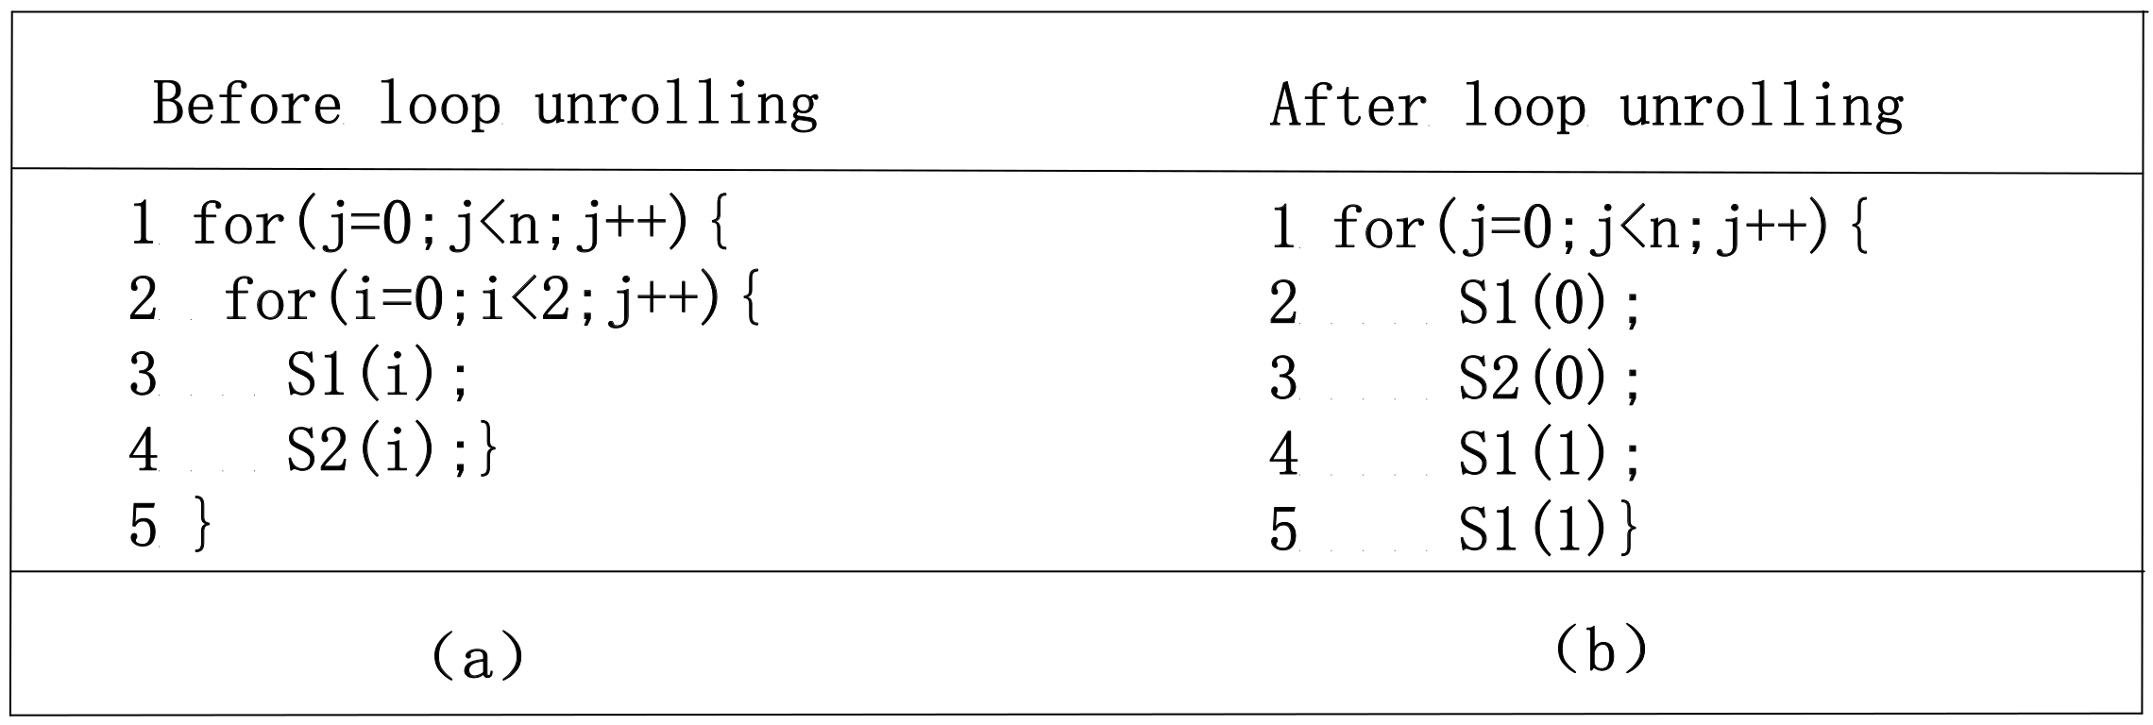
How computers can improve itselves?
I.Q differences
I.Q. Converting
A.I. as a programmer
Optimization with compiler

Slide 4
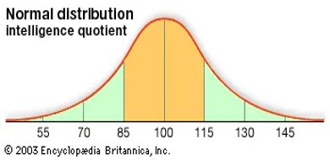
Why technological exploison more useful than intelligent one?
Tecnological and intelligent explosions

Slide 5
Main points
Humans' intelligent explosion
Computers' self-improvement
Tecnological explosion

Slide 6
Thank you for your attantion
"WHY COMPUTERS WON'T MAKE THEMSELVES SMARTER"
By Velikodnyij Vladimir
E-mail: isnt1321@gmail.com

